Slide 1
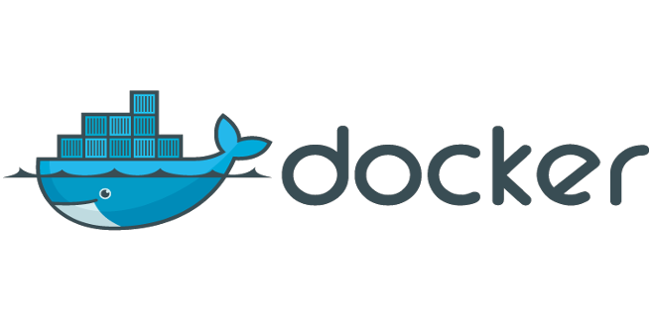






demystified
$

Slide 2
Who am I?
Pieter Franck Software Engineer

Slide 3

Who am I?
Steve Cleynen Software Engineer
@stevecleynen

Slide 4




Agenda
What’s it all about?
How does it work?
Docker in action
Go explore!

Slide 5
What’s it all about?

Slide 6
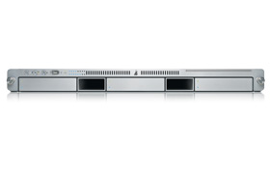
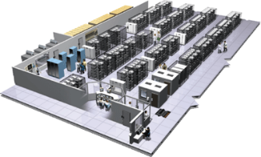
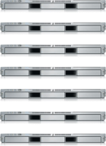


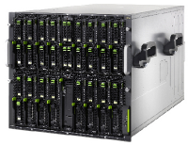
Shipping code is hard
Static website
Background workers
nginx 1.5 + modsecurity + openssl + bootstrap 2
Python 3.0 + celery + pyredis + libcurl + ffmpeg + libopencv + nodejs + phantomjs
User DB
Queue
Analytics DB
postgresql + pgv8 + v8
Redis + redis-sentinel
hadoop + hive + thrift + OpenJDK
Web frontend
Ruby + Rails + sass + Unicorn
API endpoint
Python 2.7 + Flask + pyredis + celery + psycopg + postgresql-client
Production Cluster
Public Cloud
Development VM
QA server
Disaster recovery
Contributor’s laptop
© Docker
Customer Data Center
Production Servers

Slide 7
Along came Docker
“Docker allows you to package an application with all of its dependencies into a standardized unit for software development.”
docker.com

Slide 8
Along came Docker
“Docker allows you to package an application with all of its dependencies into a standardized unit for software development.”
docker.com

Slide 9
Along came Docker
“Docker allows you to package an application with all of its dependencies into a standardized unit for software development.”
docker.com

Slide 10
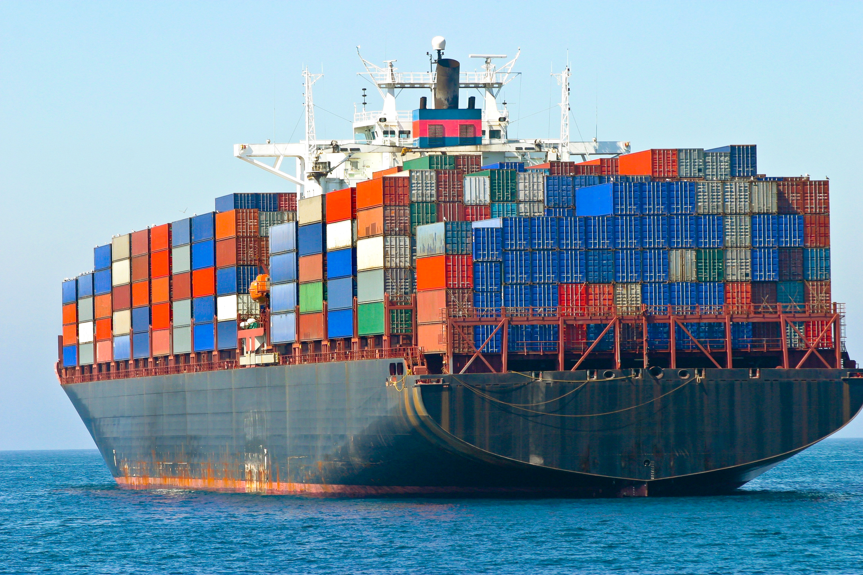
A shipping container …
Along came Docker
… for code

Slide 11
Along came Docker
“Docker allows you to package an application with all of its dependencies into a standardized unit for software development.”
docker.com

Slide 12
Docker
… a sneak preview

Slide 13
How does it work?

Slide 14
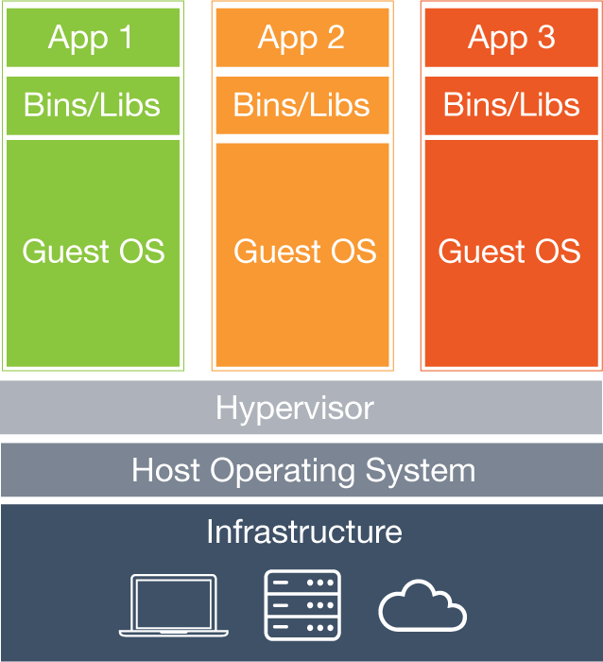
Virtual machines
Isolated,
but at a cost
© Docker

Slide 15
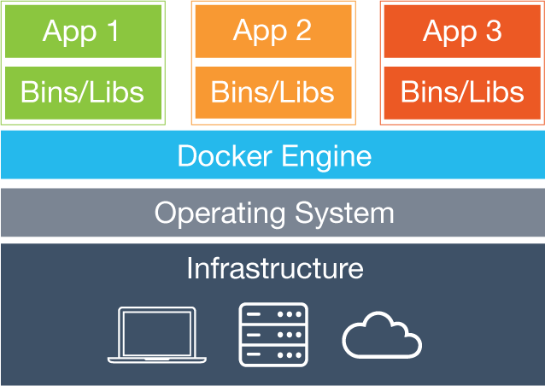
Docker containers
Isolated,
yet lean and mean
© Docker

Slide 16
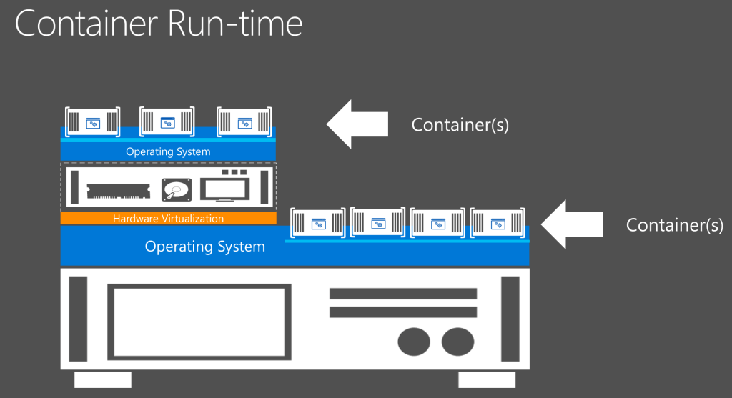
Containers and virtual machines …
Mutually exclusive?
No!

Slide 17


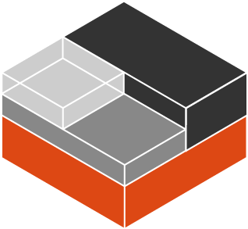

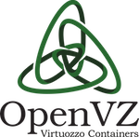

Container technology isn’t new
LXC
but Docker made it popular
https://en.wikipedia.org/wiki/Operating-system-level_virtualization

Slide 18
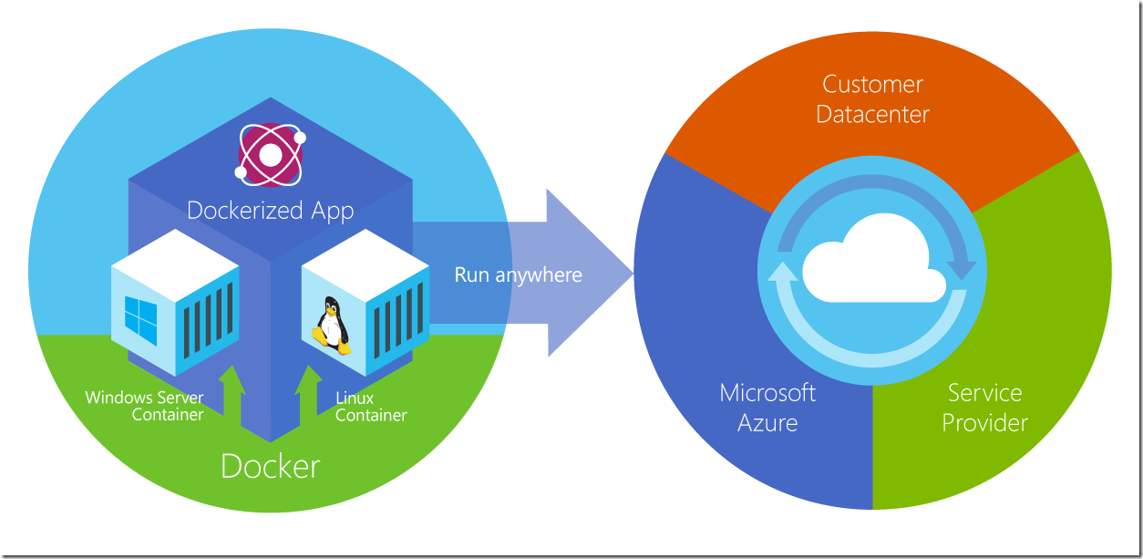
Run anywhere?
Yes, but …
© Microsoft
Notes:
Linxux containers only on linux host, windows containers only on windows server 2016 host, which us yet to come out …

Slide 19
Ship
Run
Build

Slide 20
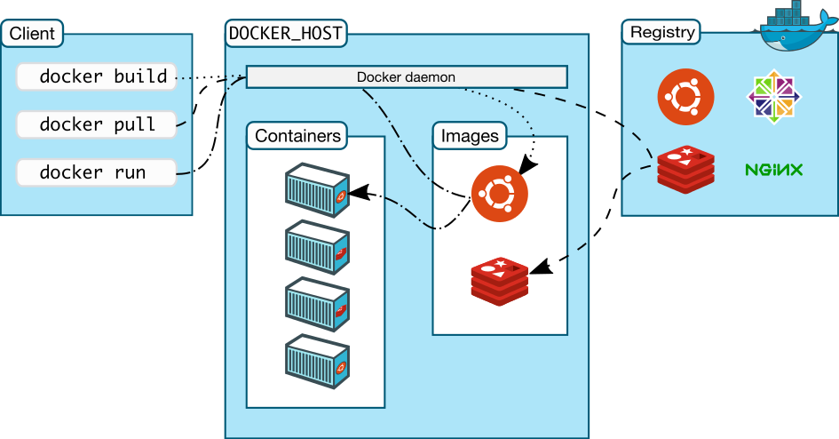
Architecture
© Docker

Slide 21
Build …
Dockerfile
FROM centos7
RUN yum -y install java-1.7.0-openjdk-devel.x86_64
ADD target/dropwizard-helloworld-1.0-SNAPSHOT.jar /
ADD hello-world.yml /
CMD ["java", "-jar", "dropwizard-helloworld-1.0-SNAPSHOT.jar", "server", "hello-world.yml"]
EXPOSE 8080
an image
Terminal
$ docker build –t my-image:v1 .
Notes:
Note that docker containers are application-centric; they only run one process. It’s like launching a command in a terminal … but only in a container.

Slide 22
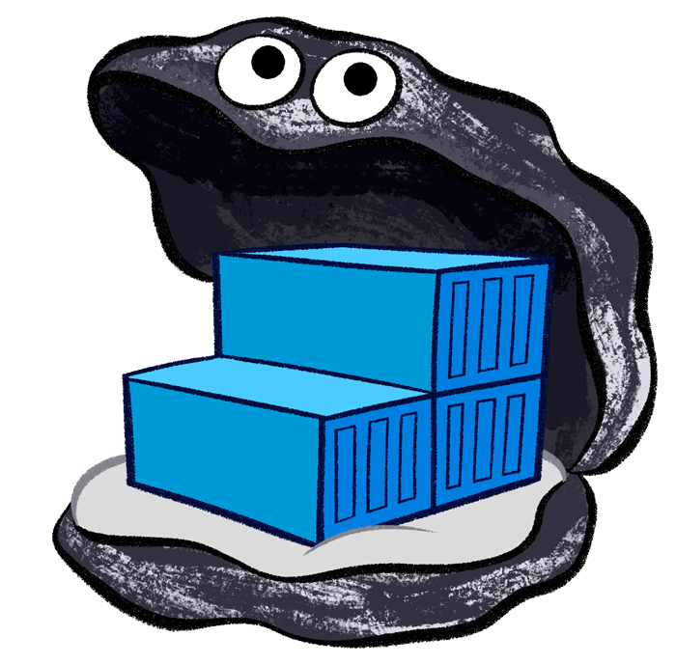
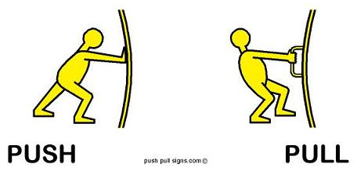

Ship …
Docker registries
a.k.a. image repositories
it around
public or private
https://hub.docker.com/
Notes:
As images packs an application with all of it’s dependencies, docker images are (most of the time) quite a lot larger then your application itself. Note that Docker OS images are optimized for containers and are small (er) in size: e.g ubuntu images 120 à 140 MB, busybox 2MB. Docker containers use layered file systems which helps a lot in making pulling and pushing images fast.

Slide 23
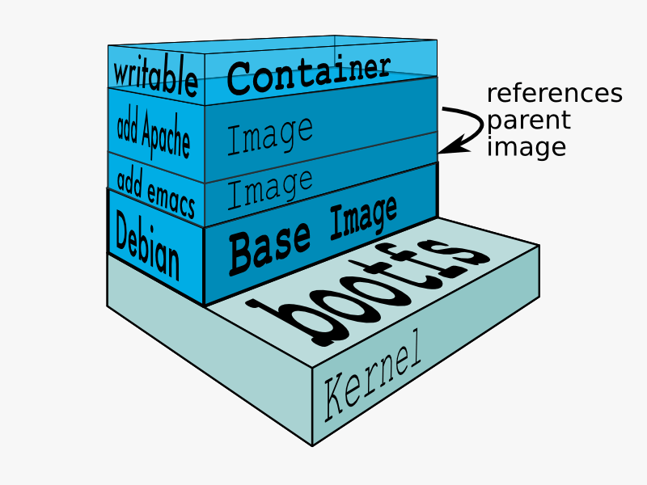
Multi-layer filesystem
© Docker

Slide 24
Run …
Terminal
$ docker run -d elasticsearch
it

Slide 25

A note about persistence
A container is disposable!
So …
volumes
build-ship-run
© Docker

Slide 26


And about networking
It’s pretty isolated …
by default.
So …
network drivers

Slide 27
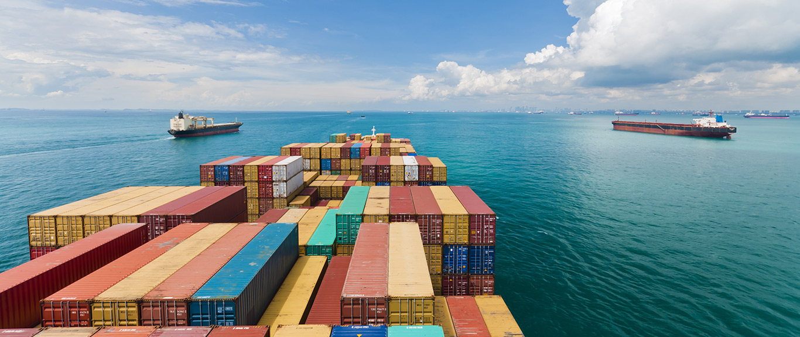
Docker in action

Slide 28

Demo!
zuul (Netflix Reverse proxy) Java
Web - Angular
Catalog
.NET Core 1.0
Cart
Nodejs
Redis (Session)
Mixing…

Slide 29
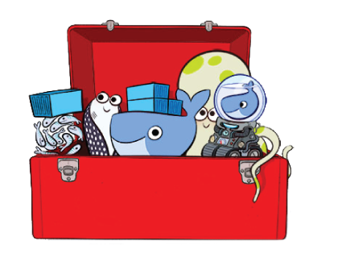
Go explore!
Swarm
Kitematic
Compose
Machine
Tutum
Registry
Engine
The toolbox …

Slide 30
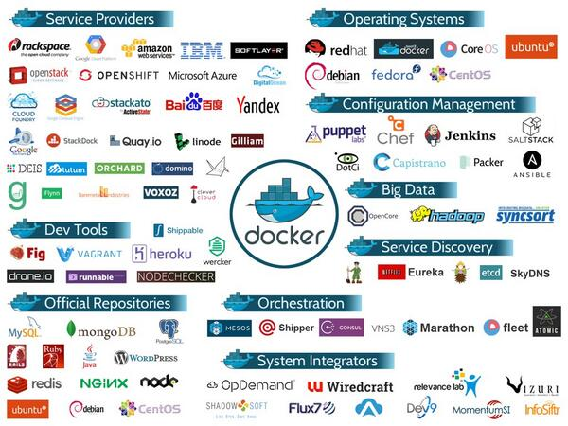
Go explore!
The ecosystem …

Slide 31
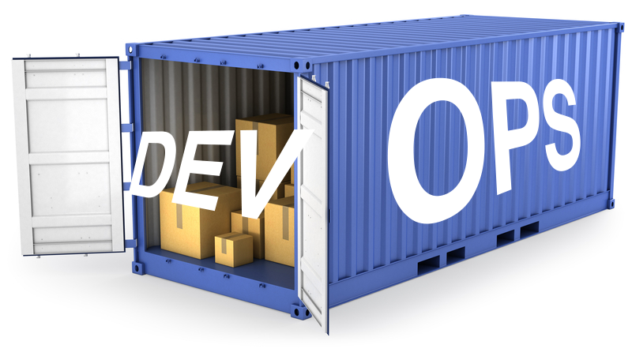
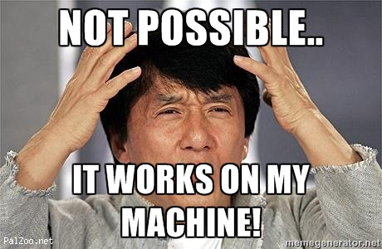
And remember
No more “It works on my machine”
Notes:
Omdat je container alles bevat qua configuratie, geinstalleerde software, enzovoort zal deze overal op elke omgeving kunnen draaien
DevOps

Slide 32
And remember
No more “It works on my machine”
Easily try out new versions, tools,…

Slide 33
And remember
No more “It works on my machine”
Easily try out new versions, tools,…
Consistent development environment
Notes:
Voorbeeld landbouw met verschillende services die op een dev server staan, problemen als deze plat ligt,….

Slide 34
And remember
No more “It works on my machine”
Easily try out new versions, tools,…
Consistent development environment
Clean machine
Notes:
Je ontwikkelmachine blijft clean

Slide 35

Q&A
Questions anyone?

Slide 36

Thank you for your time!

